Slide 1

Loan Approval Likelihood
Team Members: Desiree Diaz, Medina
Irene Okada,Wei Zhu

Slide 2
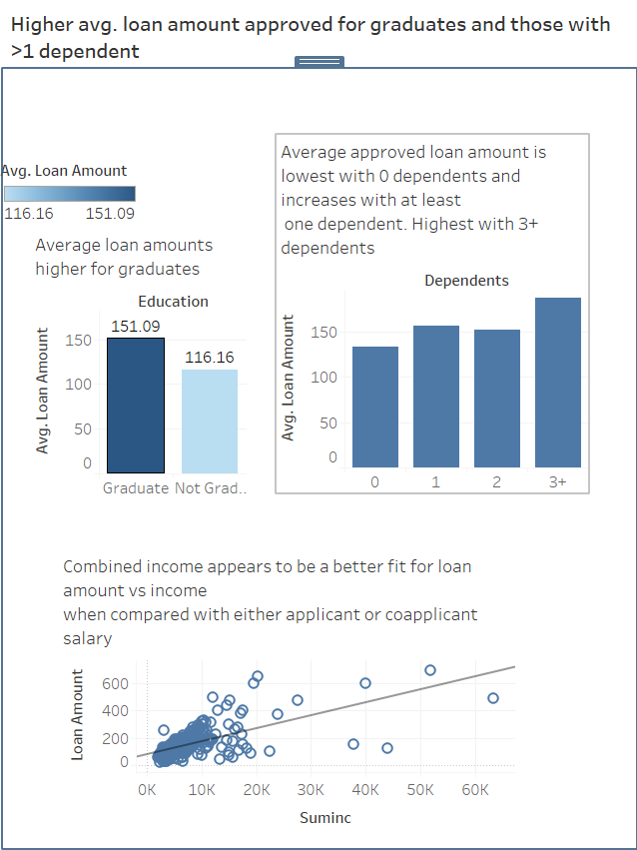
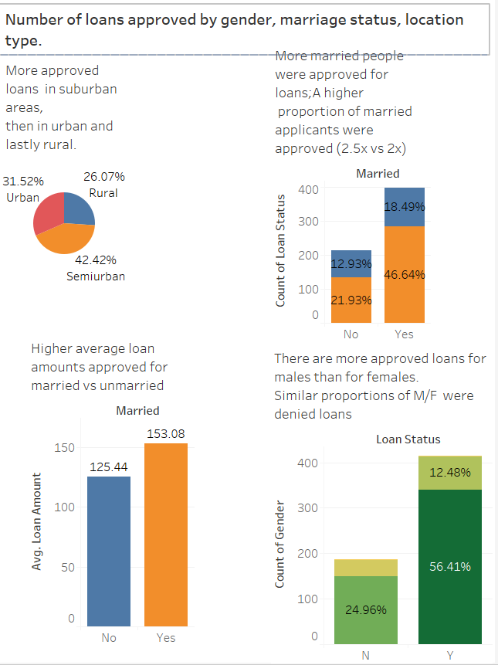

Slide 3
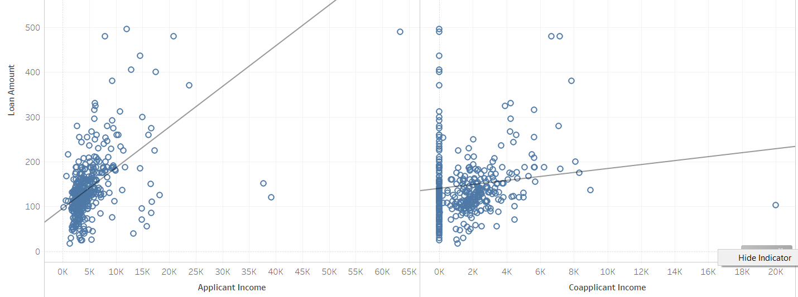
Income vs Loan amount https://public.tableau.com/profile/ireneokada

Slide 4
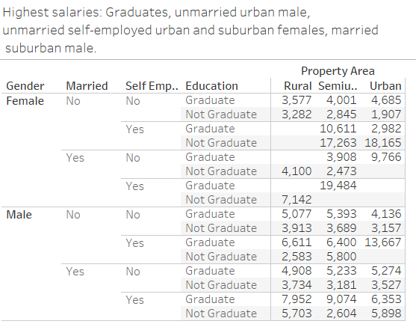
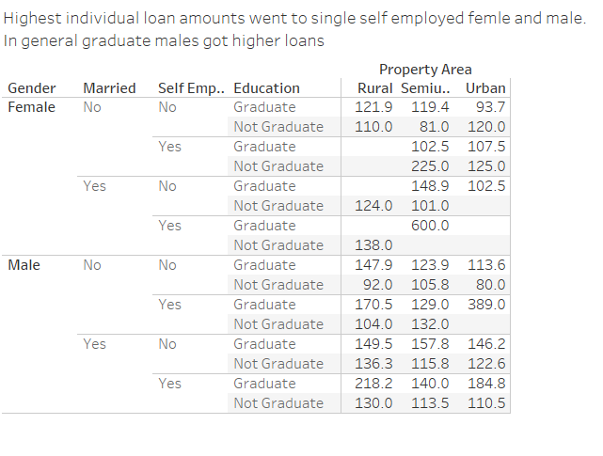
Salaries vs loan amount

